Slide 1

Evangelization and Faith Formation

Slide 2
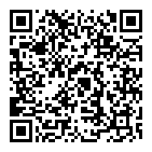
Please Pull Out Your Cell Phone!
Help Us Check Everyone In!
📱 Scan the QR code with your phone
📝 Fill out the quick attendance form
Your participation helps us stay organized

Slide 3
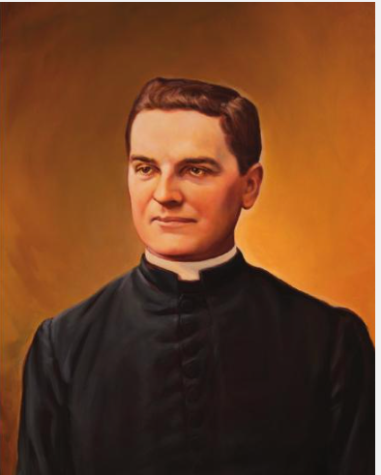

Let Us Start In Prayer
God, our Father, protector of the poor and defender of the widow and orphan, you called your priest, Blessed Michael McGivney, to be an apostle of Christian family life and to lead the young to the generous service of their neighbor. Through the example of his life and virtue, may we follow your Son, Jesus Christ, more closely, fulfilling his commandment of charity and building up his Body, which is the Church.
Let the inspiration of your servant prompt us to greater confidence in your love so that we may continue his work of caring for the needy and the outcast. We humbly ask that you glorify Blessed Michael McGivney on earth according to the design of your holy will. Through his intercession, grant the favor I now present to make this meeting meaningful to the men present. Through Christ our Lord. Amen."
Blessed Michael McGivney, pray for us!
Notes:
Let Us Begin in Prayer
As we always do, let us start in prayer. We will pray for the canonization of Blessed Father Michael McGivney, asking for his intercession and guidance in our work.
"God, our Father, protector of the poor and defender of the widow and orphan, you called your priest, Blessed Michael McGivney, to be an apostle of Christian family life and to lead the young to the generous service of their neighbor. Through the example of his life and virtue, may we follow your Son, Jesus Christ, more closely, fulfilling his commandment of charity and building up his Body, which is the Church.
Let the inspiration of your servant prompt us to greater confidence in your love so that we may continue his work of caring for the needy and the outcast. We humbly ask that you glorify Blessed Michael McGivney on earth according to the design of your holy will. Through his intercession, grant the favor I now present to make this meeting meaningful to the men present. Through Christ our Lord. Amen."
Blessed Michael McGivney, pray for us!

Slide 4

Pledge of Allegiance
Notes:
Let Us Honor Our Great Nation
Now, let us show our respect and patriotism by reciting the Pledge of Allegiance together.
"I pledge allegiance to the Flag of the United States of America,
and to the Republic for which it stands,
one Nation under God, indivisible,
with liberty and justice for all."
God bless America!

Slide 5
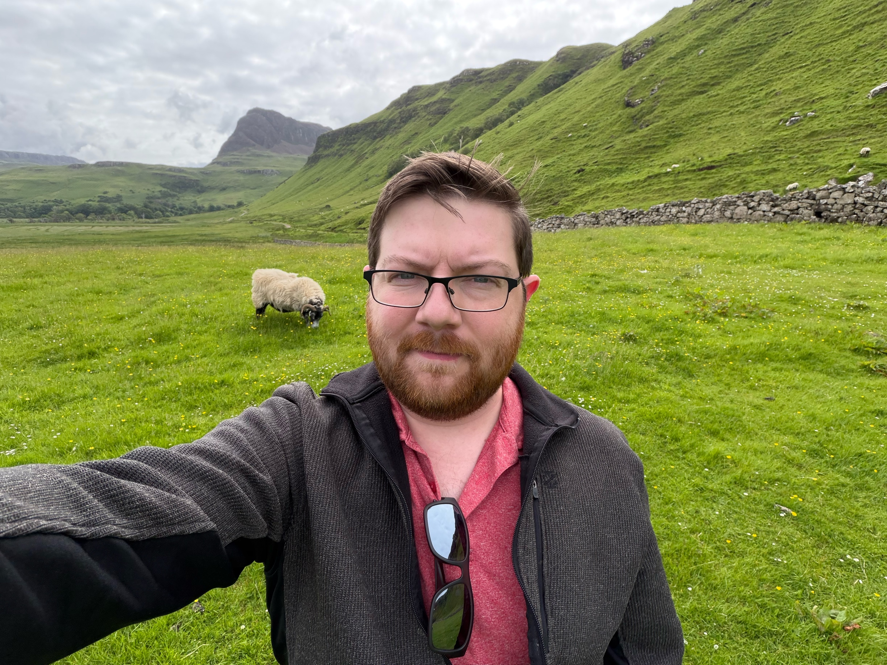

Presenters
Matthew Handley
Evangelization and Faith Formation Director, Diocese of Marquette
Notes:
Trainer Customization Instructions
Please customize this slide with your name and role before presenting.
This Train-the-Trainer session will be led by:
Joe Langhauser, State Training Director
Dean Hayworth, Training Director North
I expect that State Deputy Diocesan Directors will make any necessary customizations to tailor the presentation as required.
Thank you for your commitment to this training process!

Slide 6
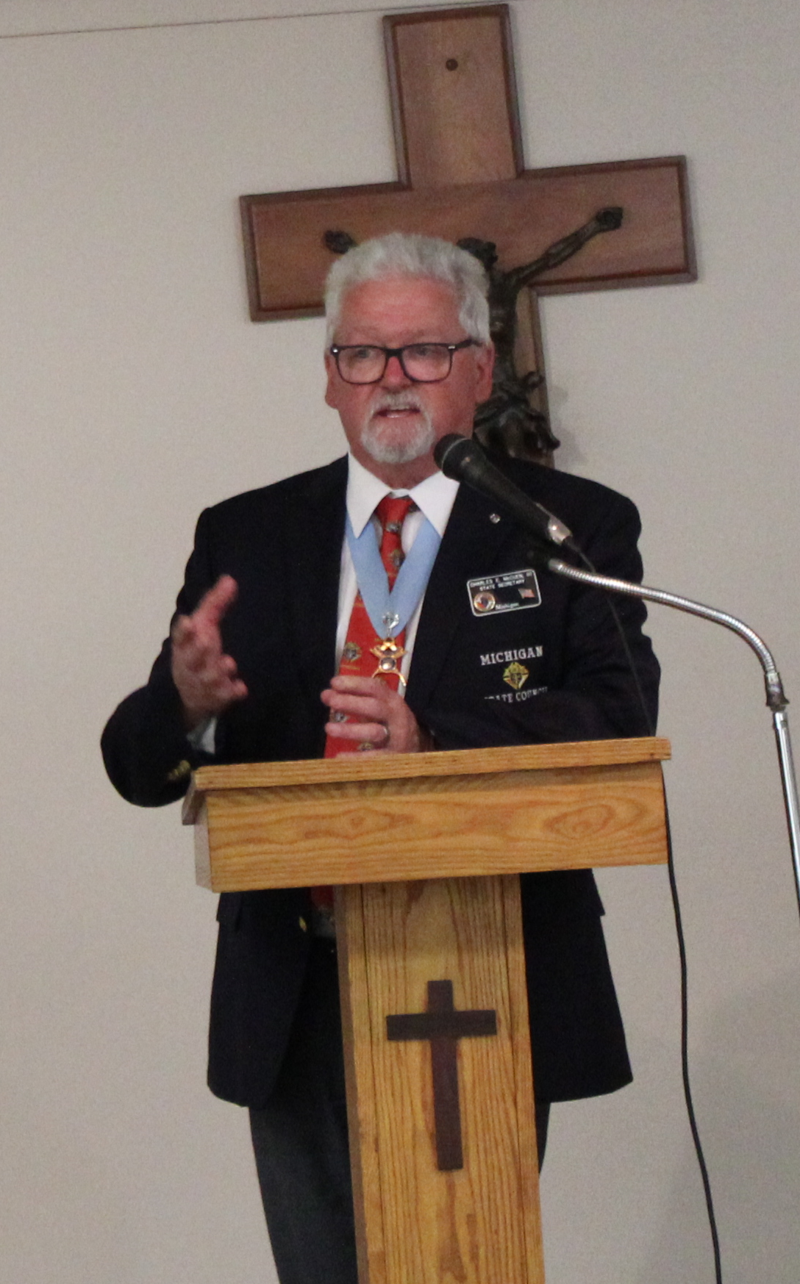
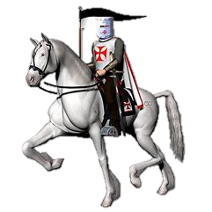
Thank You, EFF Directors & Coordinators
On behalf of the Michigan State Council, I extend my sincere gratitude to each of you for accepting the call to serve as a EFF Director for your council. Your leadership, dedication, and commitment to supporting your councils will help strengthen the mission of the Knights of Columbus across Michigan.
Together, we build faith, family, and fraternity.
— Charlie McCuen State Deputy
Notes:
As Grand Knight, you are more than just a leader—you are a catalyst for change, a builder of brotherhood, and a servant to your parish and community. Your vision and dedication will shape the future of your council.
Why Your Role Matters
You inspire Faith by leading spiritual programs that bring members closer to Christ.
You build Community by organizing events that strengthen parish and local bonds.
You support Family life through activities that uphold Catholic values.
You promote the dignity of Life by championing the vulnerable and voiceless.
Your Mission
Lead with Vision: Set clear goals that align with the mission of the Knights of Columbus.
Communicate Effectively: Keep your council informed and engaged.
Build a Strong Team: Empower your officers and members to lead and serve with you.
Serve Faithfully: Keep Christ at the center of all you do.
Remember
You are not alone. Surround yourself with great leaders, lean on your fellow Knights, and most importantly, trust in God’s guidance. Your leadership will inspire others to serve with faith, courage, and compassion.
May God bless you in this noble journey, and may Blessed Michael McGivney intercede for you as you fulfill your calling as Grand Knight.
Your council's success begins with you. Lead boldly. Serve humbly. Inspire greatly

Slide 7


Slide 8
Links to Supreme Training
Officer Training
Council Officer Training | Mar-26
Administration and Operations
Building a Communications Plan | Link
Communication Strategies for New Councils* | Soon
Guidelines for Conducting Council Meetings | Book
Navigating Council Forms | Oct-25
Public Relations and Publicity | Book
Time Management | Soon
Working With Your Pastor | Feb-25
Growth and Retention
Conducting Activity Drives | Nov-25
Conducting Church Drives | Apr-25
Making the Most of Men’s Conferences | Mar-25
Programs and Engagement
Advertising Council Events | Apr-25
Conducting Successful Programs | Soon
Engaging Your Members | Mar-25
Enhancing Member Experience | Sep-24
Integration into Parish Life* | Soon
Introducing Families to the Knights | Sep-24
Program Planning and Implementation | Soon
Programming Suggestions for Small and Remote Councils | Soon
You Are Your Programs | Soon
Link to – Resources for All Councils
Notes:
Understanding Your Role & Available Training
Over the next three slides, we will review the key responsibilities of each position within your council
We will also provide direct links to Supreme training resources for each role
We strongly encourage you to take advantage of these self-paced training modules
These courses can be completed on your own time, at your own pace
Investing time in training will help you:
Better understand your role
Improve execution
Strengthen your council’s success

Slide 9
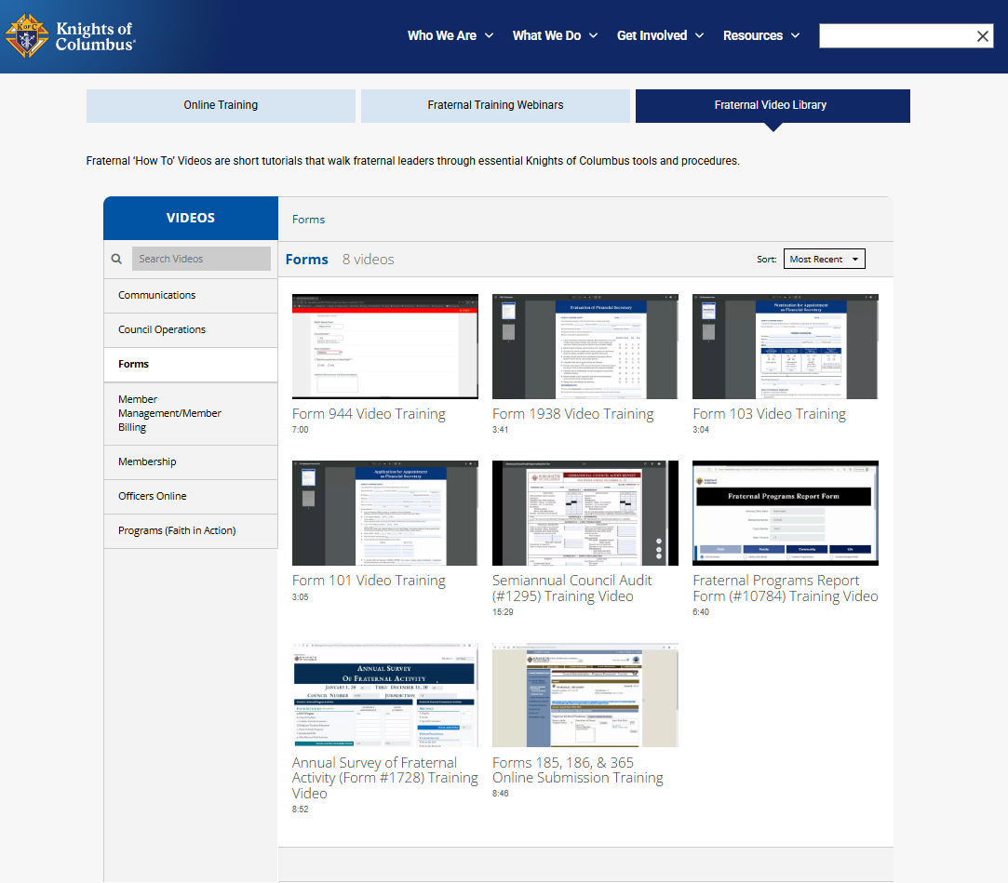
Form Filling Training
Learn by Watching
Short “How-To” videos from Supreme
Step-by-step guidance for key forms
Covers:
  Form 185, 365, 1728, 1295, 944
Ideal for:
  New officers
  Refreshers for experienced leaders
Pause, replay, and follow along
Notes:
Supreme has made form training very simple through these short ‘How-To’ videos.
Each one walks you step-by-step through how to complete specific forms like 185, 365, 1728, and the audit. These are especially helpful for new officers, but even experienced leaders can use them as a refresher.
The key advantage here is you can pause, replay, and follow along as you complete the form yourself.
This is one of the easiest ways to reduce errors, avoid missed deadlines, and ensure your council stays on track.
If you’re unsure how to complete a form—start here before asking for help

Slide 10
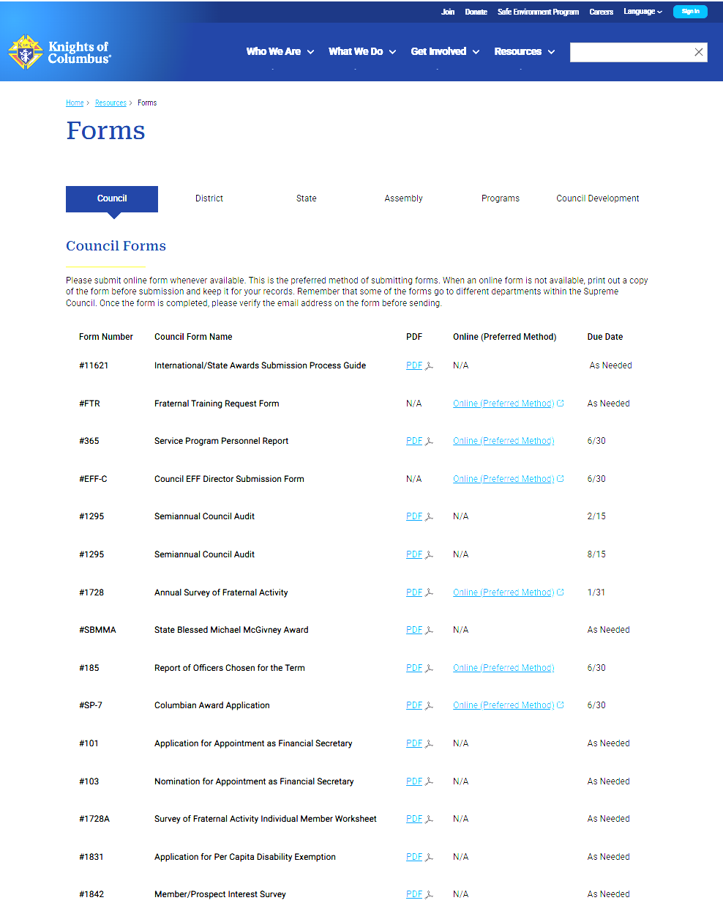
Link to Supreme Forms
Use the Knights of Columbus Forms Page as your central resource
Navigate to: Resources → Forms → Council
Preferred method: Submit forms online whenever available
Always verify:
Correct form number
Due date
Submission method (Online vs PDF)
Key forms to know:
Form 185 – Officers Chosen
Form 365 – Program Personnel
Form 1728 – Annual Survey
Form 1295 –Annual Audit
Notes:
1. Why this page matters
“This page is your command center for getting forms done correctly and on time.”
“If you don’t know where to start—start here.”
2. Online submission is the standard
“Supreme strongly prefers online submission.”
“It’s faster, more accurate, and immediately recorded.”
3. Avoid common mistakes
Submitting the wrong version of a form
Missing deadlines (especially 185, 365, 1728)
Sending PDFs when an online version exists
4. Reinforce accountability
“Forms are not optional—they are how the Order measures activity and success.”
“This is part of our ‘War on Forms’—not avoiding them, but mastering them.”
5. Leadership expectation
“Grand Knights, Financial Secretaries, and Directors should bookmark this page.”
“District Deputies—this is one of your first checkpoints with every council.”

Slide 11

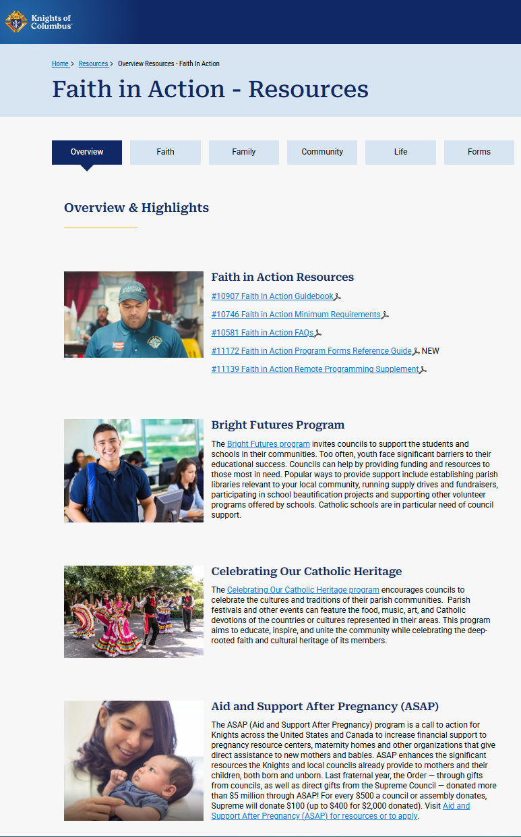
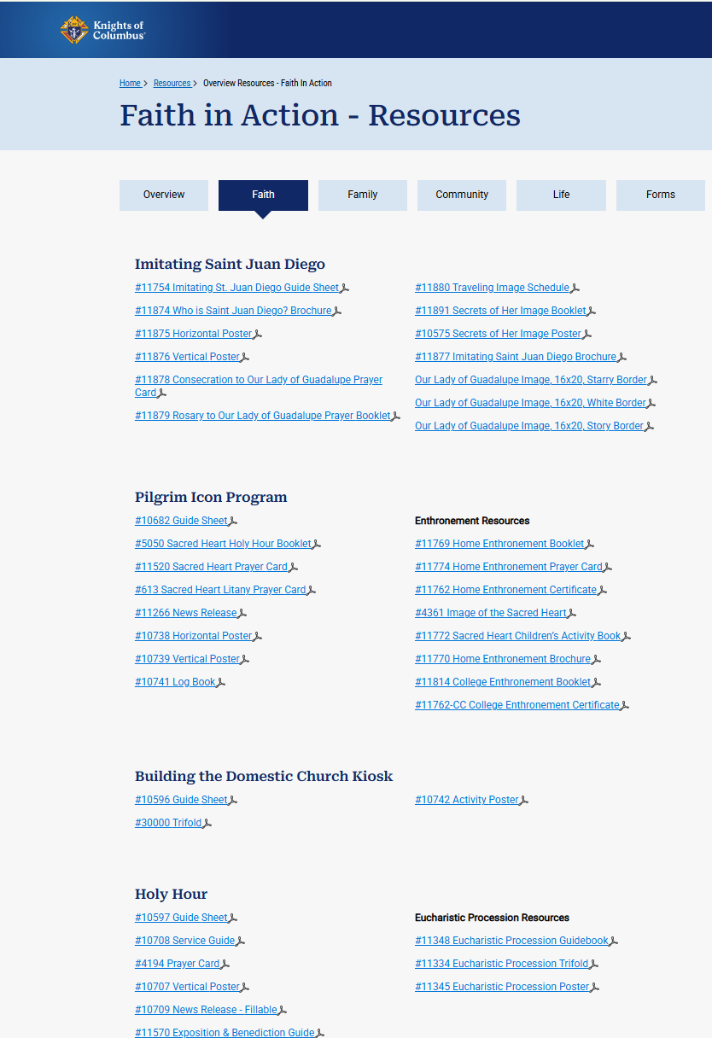
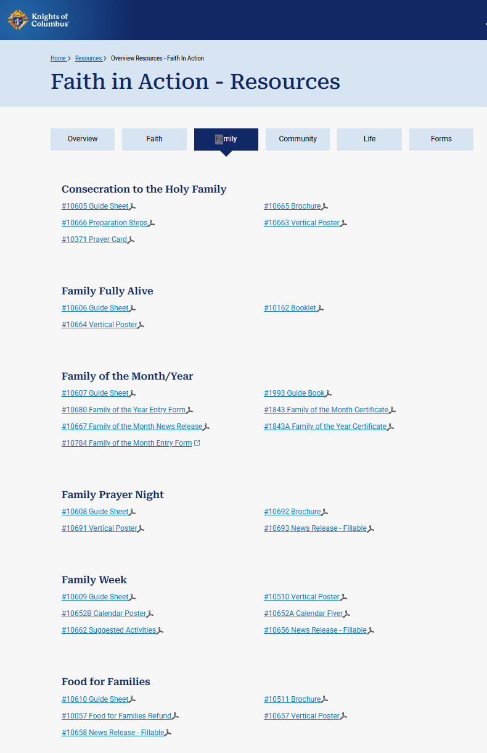
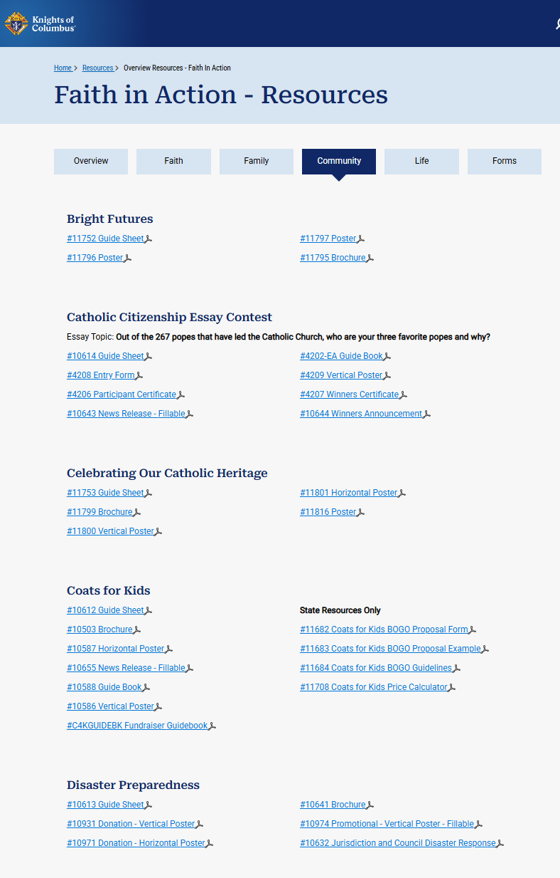
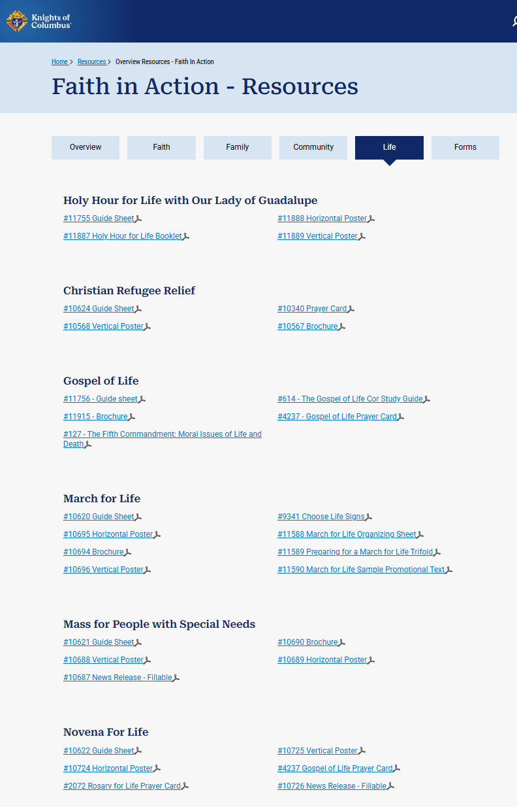
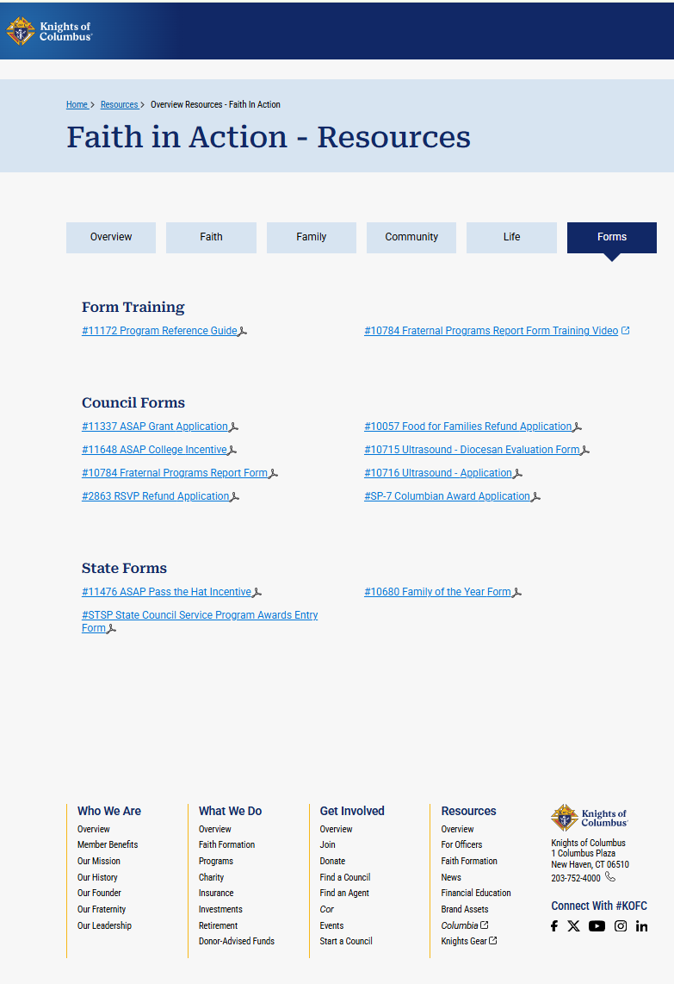
Let's Talk Programs
Overview Faith Family Community Life Forms
So Many Program Choices with Documentation
Supreme as made it easy to choose and run programs
This is a lot, however it not all inclusive
Notes:
On this slide, you’re seeing the full Faith in Action program structure from Supreme—Faith, Family, Community, and Life.
The key takeaway is this: you don’t have to create programs from scratch. Supreme has already built them out for you, with guides, resources, and documentation to help you succeed.
Now, it can feel like a lot—and it is. But you’re not expected to do everything. Your role is to choose the programs that best fit your parish and your members.
And remember, this isn’t all-inclusive. There are great things happening across Michigan as well.
Use this as your foundation, pick a few programs, and execute them well.

Slide 12

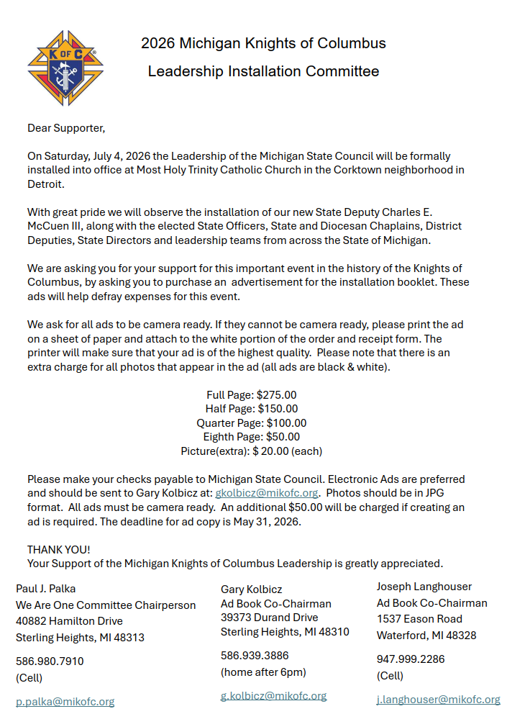
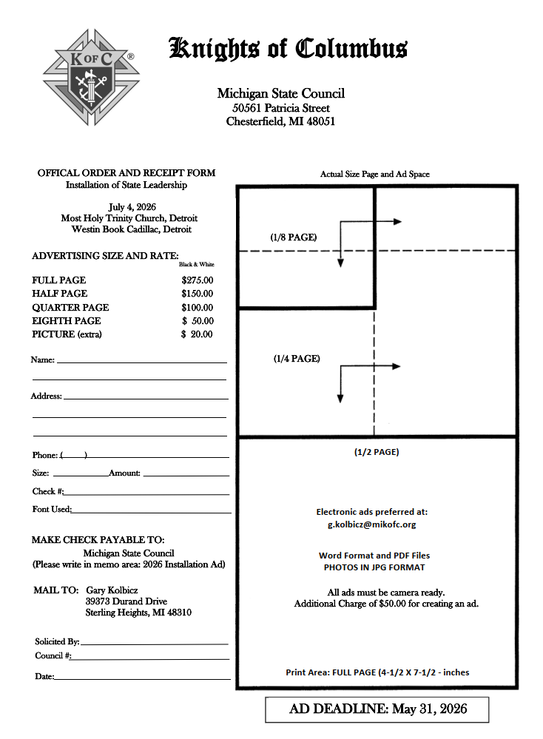
Please Consider Helping Fund State Leadership Installation Via an Add Book Donation
Honors Our New Leadership: Your council’s ad is a visible sign of support for our newly installed officers, recognizing their commitment to serve Christ, the Church, and the Order.
Supports the Installation Event: Donations help cover the costs of the diocesan installation ceremony and ad book printing, ensuring a dignified celebration worthy of the office and our shared mission.
Builds Fraternal Unity: Participating in the ad book demonstrates council solidarity across the diocese — showing that we stand together as brother Knights supporting one another’s service.
Promotes Your Council’s Good Works: Each ad provides an opportunity to showcase your council’s faith in action — highlighting your local programs, parish involvement, and commitment to charity.
Advertisement for the “We are One Committee”
Thank you for your support!

Slide 13
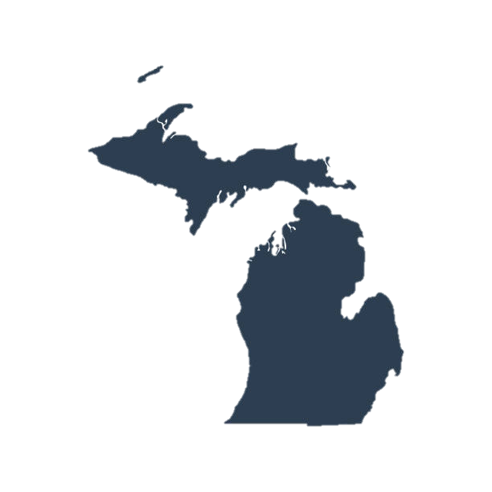
Installation Add Book Team
Ø Gaylord
1. Larry Herman
2. Roger Markham (DD201)
Ø Saginaw
1. Bradley Covaleski (DD705)
2. Richard Gilles (DD702)
Ø Detroit East
1. Wally Papciak
2. Matt Hoxie
Ø Detroit West
1. Gary Mallia (DD112)
2. Michael King (DD106)
Ø Marquette:
1. Bob Bodine
Lansing
1. Bill Leveque
2. Joe Yekulis
Ø Kalamazoo
1. Bob Bagley
Ø Grand Rapids
1. Robert Wassik
2. Larry Adams
Michael King 106
Roger Markum 201 Gayloard
Bradley Covaleski 705
Richard Gilles 702
Wally Papciak <w.papciak@mikofc.org>
Matt Hoxsie <m.hoxsie@mikofc.org>
"William Leveque Sr." <w.leveque@mikofc.org>
Joseph Yekulis <j.yekulis@mikofc.org>
Robert Bagley <r.bagley@mikofc.org>
Robert Wassick <r.wassick@mikofc.org>
Larry Adams <l.adams@mikofc.org>
Larry Herman <l.herman@mikofc.org>
District Deputy 112 <dd112@mikofc.org>
District Deputy 106 <dd106@mikofc.org>
District Deputy 705 <dd705@mikofc.org>
District Deputy 702 <dd702@mikofc.org>
District Deputy 201 <dd201@mikofc.org>

Slide 14
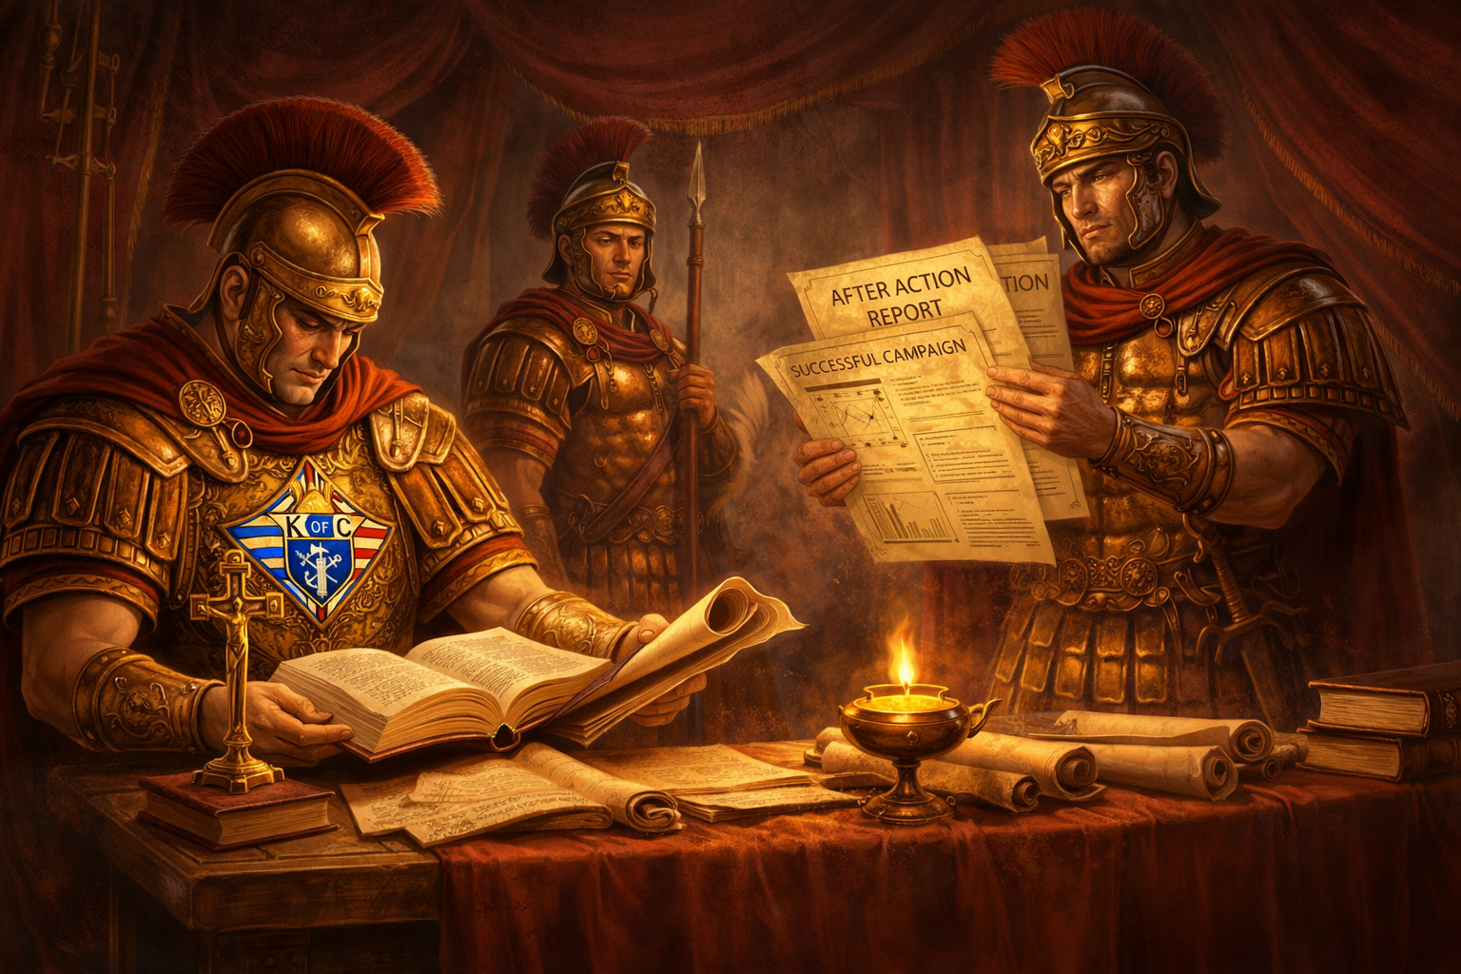
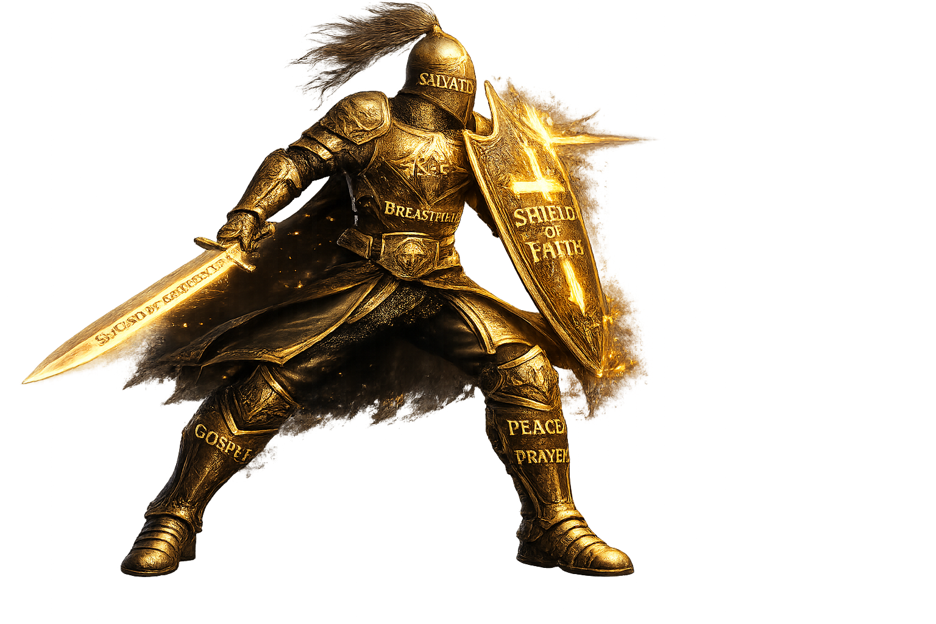

We need after action reports!
Reports are important!
War on forms
More Information to Come at the Summer Diocesan Meeting
Reports are not paperwork… they are how we deliver the mission.
Notes:
2026 -2027 we will be stressing After Action Reports: Essential, Not Optional
Let’s be honest… no one enjoys paperwork.
But After Action Reports are mission-critical to our success.
They ensure:
The right support reaches the right councils
At the right time
With the right resources
What gets reported…
Gets seen → Gets supported → Gets improved
Without timely reporting:
Needs go unmet
Successes go unnoticed
Opportunities are lost
Accountability Matters
From the State Deputy → SDDR → District Deputies → Grand Knights
We will measure and track on-time communication and form completion
In this training, you will see:
All required forms
Plus additional tools to help ensure nothing falls through the cracks
Key Takeaway
Reports are not paperwork… they are how we deliver the mission.

Slide 15
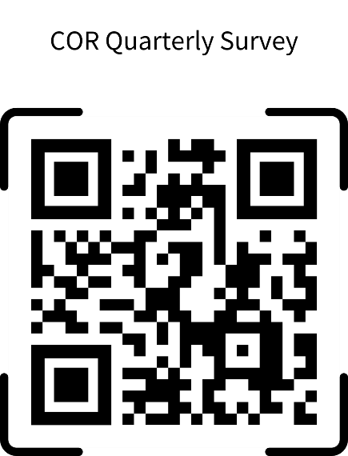
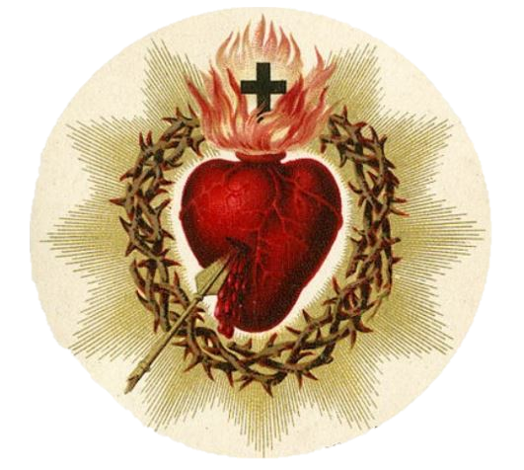
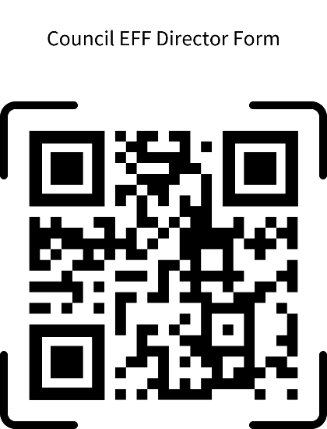
COR
The Exception to The Rule
✅ COR is NOT a Program! It does NOT get reported on the 10784 Form
Notes:
As with any rule there are exceptions:
While COR is NOT a program and does NOT go on Form 10784, we still want to track its impact.
📌 Here is the link to report your COR activities. Use it to document attendance, engagement, and spiritual growth in your parish.

Slide 16
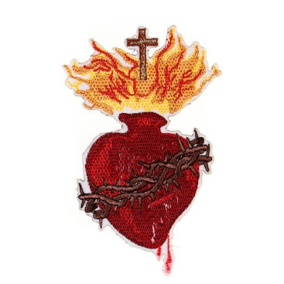
What is COR?
COR is Catholic Way of Life
✅ COR is a mission to bring men together to refocus on Jesus Christ through
shared time of prayer and formation.
✅ Open to all men of the council and parish
✅ Should utilize and collaborate with any existing men’s group or men’s ministry,
not compete with, or control it.
✅ Does not have a formal curriculum or set schedule
✅ Its goal is to strengthen brotherhood where men are comfortable and willing
to sharpen and accompany each other in the pursuit of happiness.
✅ Provide foundation of continued evangelization and discipleship for the parish and community.
✅ Refocus Catholic men on Jesus Christ and to form and strengthen them in faith and
virtue through a brotherhood committed to prayer, formation and fraternity.
Notes:
One important exception to the 10784 reporting rule is COR—it is NOT a program and does NOT get reported on Form 10784.
So what is COR? COR is a mission, designed to bring men together to refocus on Jesus Christ through shared prayer and formation. It is open to all men of the parish and council and should collaborate with existing men’s ministries—not compete with them.
Unlike a traditional program, COR does not have a set curriculum or schedule. Instead, it creates an environment where brotherhood is strengthened, allowing men to sharpen and support each other in their journey of faith.
Through COR, we build a foundation for evangelization and discipleship, helping men grow spiritually and become leaders in their families, parishes, and communities. The goal is simple: to refocus Catholic men on Christ, strengthening them in faith and virtue through prayer, formation, and fraternity

Slide 17
Key Elements of COR
Why COR?
✅ Everyone is called to be a courageous witness to Jesus Christ
✅ It is the mandate of every Catholic man to bring Jesus to a broken world.
✅ To encourage men to live his faith and build a strong relationship with God that
is rooted in prayer and the sacraments.
✅ Because we need to proactively invest in ongoing faith formation and be
part of a dynamic brotherhood
✅ Prayer – Lifting our minds and hearts to God, making Him the center of our lives.
✅ Formation – Becoming more like Christ by increasing our knowledge and love of
God and neighbor.
✅ Fraternity – Centering our brotherhood on Christ. We need Christ-centered
friendships to help us grow as leaders, husbands, fathers, and missionary disciples.
Notes:
Every Catholic man is called to be a courageous witness to Jesus Christ. It is not just a suggestion—it is our mandate to bring Jesus to a broken world. But to do that effectively, we need to strengthen our own faith.
COR exists to encourage men to truly live their faith—to build a deeper relationship with God, rooted in prayer and the sacraments. It’s about making a proactive investment in our ongoing faith formation and fostering a dynamic brotherhood that keeps us accountable and growing in holiness.
The key elements of COR are:
✅ Prayer – Lifting our minds and hearts to God, making Him the center of our lives.
✅ Formation – Becoming more like Christ by increasing our knowledge and love of God and neighbor.
✅ Fraternity – Centering our brotherhood on Christ. We need Christ-centered friendships to help us grow as leaders, husbands, fathers, and missionary disciples.
COR is not a program—it’s a movement. A mission to form stronger Catholic men who will, in turn, strengthen their families, their parishes, and their communities. Let’s embrace it together!

Slide 18
Are you already doing something that could be considered a COR meeting?
Some examples of what could be considered COR:
✅ Existing parish men's groups or ministries – If your parish already has a men's group, COR can enhance it by refocusing on Christ-centered brotherhood.
✅ Cursillo grouping – Small faith-sharing groups that encourage spiritual growth and accountability.
✅ Bible study groups – Diving into Scripture together strengthens faith and understanding.
✅ Weekend breakfast gatherings – A simple but powerful way for men to build community and faith over a meal.
✅ Praying the Rosary together – Before or after council meetings, reinforcing the importance of prayer in our lives.
✅ Eucharistic Adoration or Holy Hour – Spending time in prayerful silence before the Blessed Sacrament.
✅ Retreats or spiritual conferences – Attending or hosting faith-building events to renew our commitment to Christ.
✅ Small group faith discussions – Meeting casually at home or in a parish hall to talk about faith, family, and struggles as Catholic men. COR is flexible—it’s about bringing men together in faith, in whatever way works best for your council and parish
Notes:
COR is not a program, but a mission to bring men closer to Christ through prayer, formation, and fraternity. It can take many forms, including:
✅ Existing parish men's groups or ministries – If your parish already has a men's group, COR can enhance it by refocusing on Christ-centered brotherhood.
✅ Cursillo grouping – Small faith-sharing groups that encourage spiritual growth and accountability.
✅ Bible study groups – Diving into Scripture together strengthens faith and understanding.
✅ Weekend breakfast gatherings – A simple but powerful way for men to build community and faith over a meal.
✅ Praying the Rosary together – Before or after council meetings, reinforcing the importance of prayer in our lives.
✅ Eucharistic Adoration or Holy Hour – Spending time in prayerful silence before the Blessed Sacrament.
✅ Retreats or spiritual conferences – Attending or hosting faith-building events to renew our commitment to Christ.
✅ Small group faith discussions – Meeting casually at home or in a parish hall to talk about faith, family, and struggles as Catholic men.
COR is flexible—it’s about bringing men together in faith, in whatever way works best for your council and parish

Slide 19
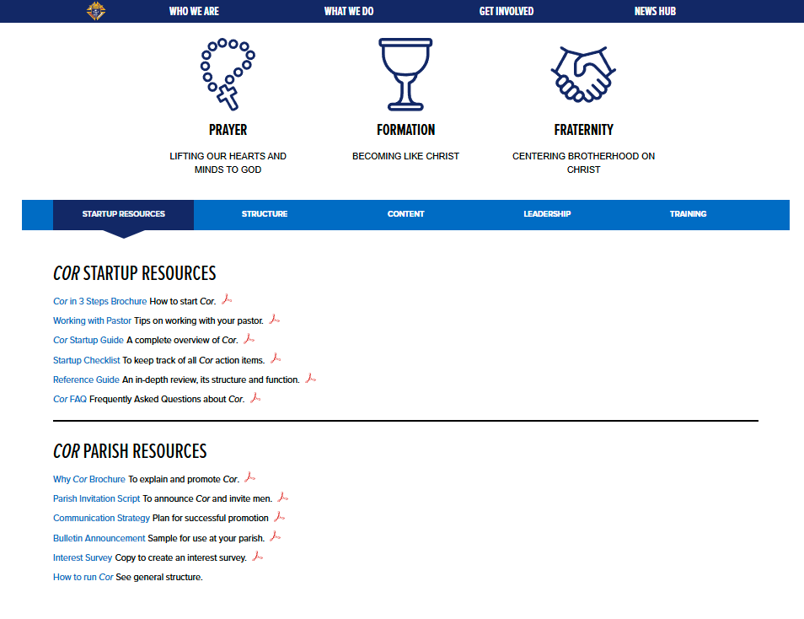
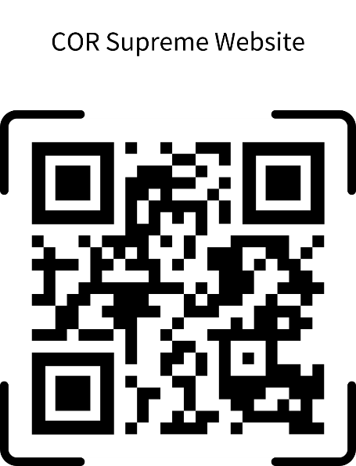
COR Resources
For more information on COR, navigate to kofc.org website, and in the searchbar, enter “COR”, then select the first result.
or you can click on this link: https://www.kofc.org/en/who-we-are/our-faith/cor.html
Download the Cor Startup Guide:
Notes:
At the bottom of the COR Home Page, you’ll find a great startup document that provides everything you need to launch and sustain a successful COR group in your parish.
This resource includes:
✅ Guidance on structuring your meetings
✅ Best practices for engaging men in faith, prayer, and fraternity
✅ Ideas for integrating COR with existing parish ministries
If you’re looking for a solid foundation to get COR started in your council, this document is the perfect place to begin. Be sure to download and review it!

Slide 20
Christ-Centered Brotherhood
In a world that often promotes isolation, we can forget that God designed us for community. We are not meant to walk this journey of faith alone.
The bond of Christ-centered brotherhood helps men remain focused on their mission to grow in holiness. It fosters a sense of duty to one another — we are our brother’s keeper. We strive to support one another in becoming the husbands, fathers and saints that God calls us to be.
As the center of our bond, Jesus is the unifying source of our strength, purpose, and direction.

Slide 21
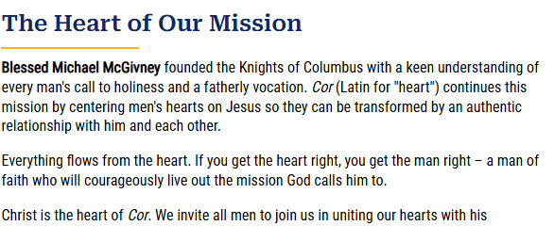
Christ-Centered Brotherhood

Slide 22
2026-27 Goals
Council EFF Directors – 50% by 9/30 and 75% by 12/31
COR at lease quarterly at each Council that expresses interest (DD survey)
At least 2 Retreat-in-a-Box in each Diocese
Spreadsheet of all Cor activities within each Diocese, updated at least quarterly

Slide 23
Diocesan EFF Coordinator
Champion Council EFF Director signup efforts with the Diocese
Encourage and remind councils to complete Cor Quarterly Surveys
Encourage attendance from their councils at quarterly EFF virtual meetings

Slide 24
Diocesan EFF Coordinator
Collaborate with councils on starting COR initiative
Establish contact with Council EFF Directors, GK if no Director is appointed, to track Cor initiative
Lead the planning and execution of Retreat-in-a-Box within the Diocese

Slide 25
Finding your Council EFF Director
Presence within the Parish
  Weekly Mass, attending or volunteering at events, etc.
Organization
  Schedule recurring meetings at the Parish
  Communicate to and through the council
  Plan Cor content
  Execute or delegate setup and execution of Cor meetings

Slide 26
Finding your Council EFF Director
Communication
  Ongoing dialogue with the Parish about Cor
  Marketing to the Parish and Council
  Communication to the Council regarding the Cor initiative
Technology
  Ability to navigate KofC.org/cor to existing Cor content and complete quarterly survey

Slide 27
Starting Cor at your Parish
Familiarize yourself with the Cor Startup Resources
  KofC.org/cor How to Lead Cor (button)
    https://www.kofc.org/resources/officer-resources/engagement/cor-leadership/how-to-lead-cor
      Cor Startup Guide
      Working with your Pastor
      Working with Men’s Ministries
      Cor A Guide for Clergy
      Reference Guide
      Cor Formation Content Guide
      Startup Checklist
      …and more!

Slide 28
Starting Cor at your Parish
Watch the Cor Training Videos
  KofC.org/cor How to Lead Cor (button) Training Videos (button)
    https://www.kofc.org/resources/officer-resources/engagement/cor-leadership/cor-training-videos
  Sean Pott, Senior Director of Evangelization and Education, will further prepare you on the following topics
    The mission of Cor, what it is, and why we are passionate about it
    How to get buy-in from the council and Parish
    How to structure Cor and choose content
    How to share about Cor and get men to join
    Communication Strategy
    How to run Cor

Slide 29
Starting Cor at your Parish
Familiarize yourself with Cor content
  KofC.org/cor How to Lead Cor (button) Content (button)
    https://www.kofc.org/resources/officer-resources/engagement/cor-leadership/how-to-lead-cor/#tabset=tabset-tab-cor-leader-resources&tab=tab-block-29171
  Videos
  Faith in Action Programs
  Bible study/Selected reading
Download or order the support material for content of interest
  Enough to present to Parish and Council leadership

Slide 30
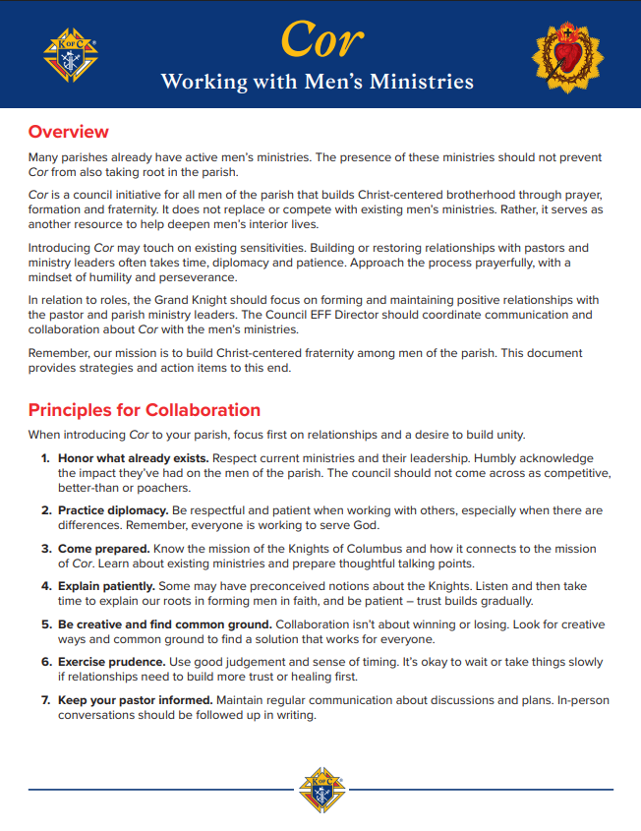
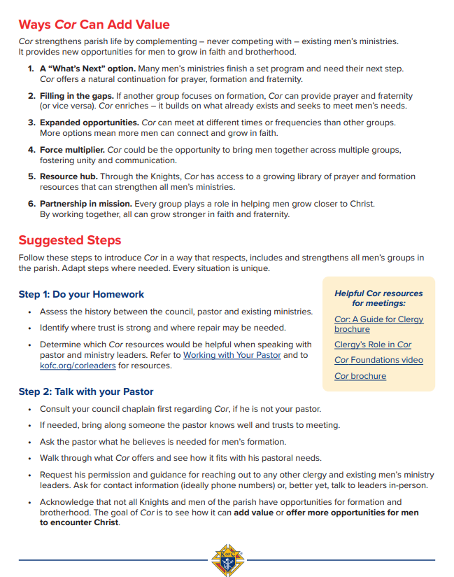
Starting Cor at your Parish
  Prepare for objections: We already have enough Men’s Groups

Slide 31
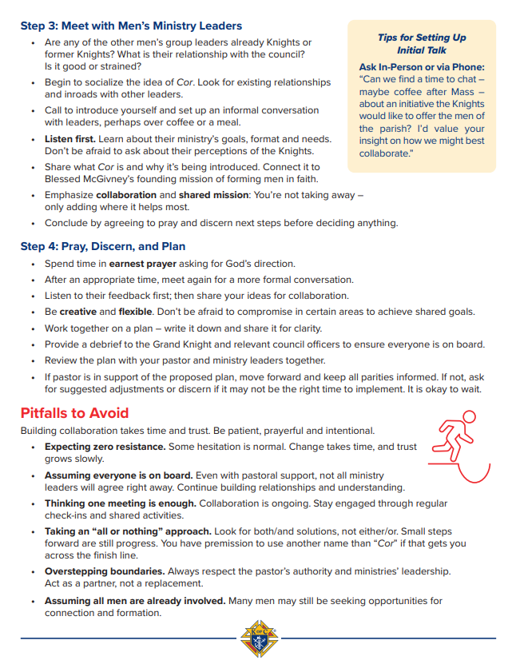
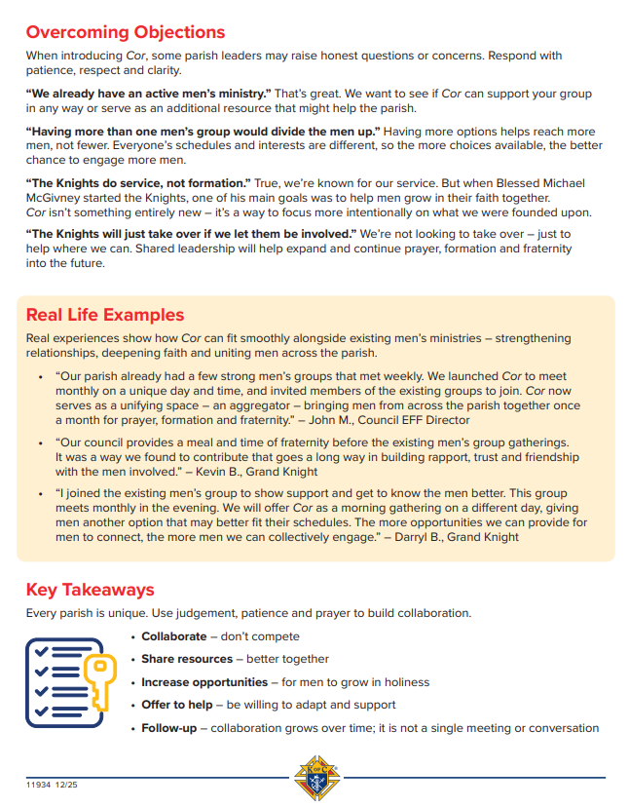
Starting Cor at your Parish
  Prepare for objections: We already have enough Men’s Groups

Slide 32
Starting Cor at your Parish
Now you are ready to schedule a meeting with your Pastor!
Invite the GK and/or Faith Director to join you
Use the tips in Working with your Pastor (startup resources)
  Be prepared to explain Cor and how it fits in with the mission of the Parish
  Be prepared to explain how Cor can work with existing Men’s groups
    With, NOT instead of
  Have multiple examples of Cor content and support materials
  Be prepared to schedule 3+ months’ worth of Cor

Slide 33

Running Cor

Slide 34
Running Cor
Build your TEAM
Refer to the Building a Team video
  PRAY and look at who the Lord has put in your life
  Who is going to create YOUR Cor content from the data on the Supreme site
  Who will create bulletin and social media ads
  Who will deliver the pulpit announcement and be available after Mass
  Who will lead prayer and the Cor transitions during gatherings
  Who will bring the food

Slide 35
Running Cor
Get the word out!
Refer to the Communication Strategy flyer
  Bulletin Announcement
  Pulpit Announcement
  Posters
  Emails
  Social Media
  Create a short survey with QR code link

Slide 36
Running Cor
Set the agenda
Pick the general structure for Cor
  KofC.org/cor How to Lead Cor (button) Structure (button)
    Click, “See a sample structure for different types of content emphasis”
    https://www.kofc.org/resources/officer-resources/engagement/cor-leadership/cor-structure
  Does your meeting fall within one of the 4 examples or a combination of a few?
Use the chosen structure to create an agenda
  Suggestion: highlight time ranges for each major item on the agenda

Slide 37
Running Cor
Cor Execution
Set up the room
  Foster small-group discussions
    If the group is larger than 8-10 members, breaking into small groups for discussion is often beneficial
    Arrange the tables and/or chairs in a way that transition from large group to small group is smooth
  If videos are being used, test the equipment!
  If food is being served, ensure that the space and accommodations are adequate

Slide 38
Running Cor
Cor Execution
Start on time
End on time
Collect contact info from participants
Encourage them to invite others
Announce/remind attendees of the next gathering

Slide 39
Reporting
EFF Director Submission Form (supreme)
  Once each fraternal year
Cor Quarterly Form (supreme)
  By the end of each quarter. No penalty for multiple submissions
Cor General Info
  Day, time, location, and general structure should be shared with the Diocesan EFF Coordinators upon starting Cor or when changing.

Slide 40
Cor Content

Slide 41
Videos
Into the Breach – The Original
  12 episode video series
  Each episode focuses on a different aspect of authentic Catholic masculinity and features interviews with well-known Catholic commentators, as well as the personal story of a man who has deeply experienced the episode’s topic in his own life. Each episode runs approximately 12 minutes.
    Masculinity, Brotherhood, Leadership, Fatherhood, Family, Life, Prayer, Suffering, Sacramental Life, Spiritual Warfare, Evangelization, and The Cornerstone.
  Reflection guides for small group discussion, as well as detailed instructions on program implementation and a toolkit for offering the program can be found at kofc.org/intothebreach

Slide 42
Videos
Into the Breach – The Mission of the Family
  5 episode video series
  Each episode focuses on a different aspect of the reality of Catholic marriage and family life, and features expert interviews with well-known Catholic commentators, as well as the powerful personal story of a Catholic couple who has lived the theme of the episode in their own married lives. Each episode runs approximately 12 minutes.
    The Catholic Family in a Post-Christian World, Marriage: The Foundation of the Family, The Gift of Children, Healing in the Family, and Creating a Legacy of Faith.
  A study guide for guided small group discussion, as well as detailed instructions on program implementation and a toolkit for offering the program, can be found at kofc.org/missionofthefamily.

Slide 43
Videos
Into the Breach – The Dignity of Work
  5 episode video series
  Each episode focuses on a different aspect of the experience of human work and features expert interviews with well-known Catholic commentators, as well as the powerful personal story of a Catholic man who has lived the theme of the episode in his own life. Each episode runs approximately 12 minutes.
    God’s Mission for Man, Work and Holiness, Work Life and Family Life, Work and the World, and Putting Work in Its Place.
  A study guide for guided small group discussion, a prayer card, and promotional brochures and posters can be found at kofc.org/intothebreach.

Slide 44
Bible Study
Men of the Word – The Good News
  Purchase study guides
    $19.99 each or $14.99 each if you buy 10+
  Study guides clearly map each of the 12 sessions of the Bible Study
    Session 1: The Good News
    Session 2: Created for Good
    Session 3: Lectio Divina – The Good Man
    Session 4: Fallen through Sin
    Session 5: God’s Divine Rescue
    Session 6: Lectio Divina – The Fallen Man
    Session 7: Jesus – Incarnate Teacher
    Session 8: Jesus – Crucified Savior
    Session 9: Lectio Divina – The Blessed Man
    Session 10: Jesus – Resurrected Lord
    Session 11: Invitation to Discipleship
    Session 12: Lectio Divina – The Redeemed Man

Slide 45
Cor Formation Guides
Digital (free) or printed ($1 - $4.99) guides that walk you through Cor sessions with readings, discussion prompts, and reflection
  Blessed McGivney Cor Session Guide
    10 sessions
  The Eucharist Cor Session Guide
    5 sessions
  Pope Francis: The Joy of the Gospel
    6 sessions
  Freedom and Faithfulness
    9 sessions
  And more!

Slide 46
Faith in Action Programs
Holy Hours
  Holy Hours feature the exposition and benediction of the Blessed Sacrament and can also include a reflection, communal rosary, prayers for intercession by Blessed Michael McGivney or St. Joseph, and other devotions as decided by the council and pastor.
The Rosary Program
  The Rosary Program encourages councils to schedule regular rosary prayer services on any day of the week, at any time of the year, with the guidance of their pastor. Councils should personally invite each family of the parish and offer attending families a copy of the Knights of Columbus Catholic Information Service’s® A Scriptural Rosary for the Family (#319). Encourage families to read this booklet and learn how their faith can be strengthened through a devotion to Our Lady, while praying the rosary at home together regularly.

Slide 47
Faith in Action Programs
Supreme Chaplain’s Monthly Challenge
  Each month, Archbishop William Lori – Supreme Chaplain of the Knights of Columbus – selects a brief passage from the Gospel reading of one of the Sunday Masses of the month.
  Archbishop Lori shares a brief reflection on the passage and issues a challenge for men to live for the month.
  The next month, men undertaking the challenge as a group gather and share their experiences living the challenge.
  The Supreme Chaplain’s Monthly Challenge is ideally suited for Cor, but can also be done in other group settings or individually.
  By taking up the Supreme Chaplain’s Monthly Challenge, men take direct, concrete action to grow in their faith and help their brothers do so as well.

Slide 48
Other common content
Formed Series
  Courses, videos, and seasonal series that can be used as Cor content. Discussion prompts and/or questions will have to be created by CEFF and team.
That Man Is You (TMIY)
  Similar structure to Into the Breach video series: Time for a meal, 30 minutes for a video, and 30 minutes for small group discussion.

Slide 49
Heart of the Gospel Retreat

Slide 50
Heart of the Gospel Retreat
A retreat can be a radically rejuvenating event!
These retreats can also be the thing that spreads awareness of Cor throughout our jurisdiction.

Slide 51
Retreat Planning
Start with your Pastor
  If possible, choose multiple dates that could work to make collaboration with other Parishes easier
  Dates should be a minimum of 2 months out, preferably 3+ months.
Contact your Diocesan EFF Coordinator
  DEFF will make SDDR and DDs aware
  DEFF will help coordinate with neighboring council leadership

Slide 52
Retreat Planning
8 weeks to Retreat
  Have a date and time secured
  Have a venue reserved
    Single room seating for the whole group
    A/V capabilities for the large group
    Enough breakout rooms/areas to accommodate everyone in groups of approx. 8 -12 men
    Space for beverages and snacks to be displayed throughout
    Space to serve everyone lunch
  Be scheduled for a pulpit announcement within the next 2 weeks
    Ask your neighboring councils to do the same

Slide 53
Retreat Planning
7 weeks to Retreat
  Finalize catering for the event
    Suggestion: lock in number as close to retreat date as possible
  Final approval of the printed marketing and pulpit announcement script
    Theme and speaker, front and center
    Are you charging to cover the cost of lunch? If so, how are you collecting money? Link/QR Code
    Communicate the max capacity of the event
    Communicate the deadline to sign up
    Communicate minimum age, generally high school
    Link to sign up as a volunteer for the event
  Reach out to Diocese for marketing

Slide 54

Retreat Planning
7 weeks to Retreat (continued)
  Volunteers needed
    Set up team
    Check-in team
    Refreshment set-up, monitor, clean-up
    Lunch servers
    Small group facilitators
    COR info team
    Clean up team
    Tear down team

Slide 55
Retreat Planning
7 weeks to Retreat (continued)
  First bulletin ad is placed
  Social media posts/ads to start
    Through council and Parish (if allowed)
  Flyers passed out at Cor throughout diocese
    DEFF will get printable flyer emailed to other CEFF Directors
  Announcements made at council meetings
  Posters hung on Council and Parish bulletin boards
  First emails are sent
    Through council, Parish, and school (if possible)

Slide 56
Retreat Planning
USE THE RIGHT IMAGES.
The emblem of our order is a trademarked image. Supreme has very specific instructions on how it must be used.
Council Officers: You can access the official emblems of the order by logging into the Supreme website, clicking Supplies Online, then clicking Asset Library.
Anyone else can find the logos and the instructions on how to properly use them here: https://www.kofc.org/resources/brand-assets/

Slide 57
Retreat Planning
4 weeks to Retreat
  Bulletin ads and social media refreshed
    Note area of focus: “more volunteers needed”, “sign up TODAY to reserve your spot”, etc.
  DEFF and host CEFF meet to discuss progress
    Attendance levels, volunteer progress, feedback/questions
    Call on neighboring CEFF, GKs, and DDs if needed
  2nd pulpit announcement or gathering area info table planned
    Host council and neighboring councils
  DEFF and all CEFF to update Cor info spreadsheet
  Schedule short rehearsal for the retreat facilitator and all with speaking duties

Slide 58
Retreat Planning
2 weeks to Retreat
  2nd pulpit announcement or gathering area info table completed
  2nd and final email is sent
    Approaching deadline highlighted – urgent call to action
1 week to Retreat
  Print Cor info spreadsheet to be handed to all attendees
  Email itinerary and pertinent parking/building information to all registered participants
  Ask participants to pray for the retreat, that those in attendance have a heart open to God’s presence and a desire for spiritual renewal.

Slide 59
Heart of the Gospel Retreat
Name tags, agenda, building map, and small group assignments at check-in
Opening Prayer
Introduction and layout of the day
  Agenda, building layout, etc.
Videos
Small Group Discussion
  Volunteers and clearly marked rooms/spaces
Lunch

Slide 60
Heart of the Gospel Retreat
Videos
Small Group Discussion
  Same groups as before lunch
Closing Comments
  Introduction of key people
  Brief explanation of the Cor info spreadsheet
  THANK YOU for attending
Closing Prayer
Dismissal

Slide 61
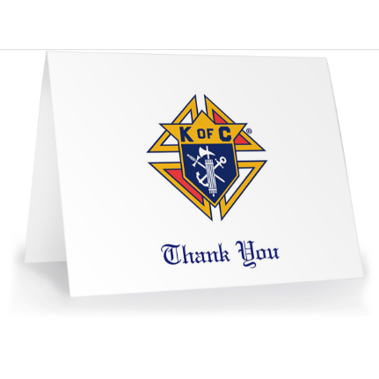
Retreat Follow up
Immediately following the retreat
  Thank you emails to all participants
    Include a digital copy of the Cor info spreadsheet
  Thank you phone call or visit to the host Pastor
  Thank you emails to all neighboring councils that helped spread the word
  Thank you letters to all Parishes that helped spread the word
  DEFF and CEFF quick meeting to note area of success and opportunity

Slide 62

Questions?
Notes:
Before We Wrap Up – Any Questions?
I want to thank you all for your time and dedication. You now have the tools and resources to make your council stronger and more effective.
Before we close, do you have any questions or concerns?
Is there anything that needs further clarification?
Do you need help with a specific area?
Are there any challenges you foresee in implementing what we've discussed?
This is your opportunity to ask, and I’m happy to help! If something comes up later, don’t hesitate to reach out to your District Deputy, State Directors, or myself.
Thank you again for your commitment—let’s make this a great fraternal year! Vivat Jesus!

Slide 63

Resources
You don’t have to “know” everything.
You just need to “know” where to find the answers
Faith In Action Manual (#10590)
Leadership Guide (Found at MIKOFC.org)
Supreme website (www.kofc.org)
State website (www.mikofc.org)
Council Officers and Past Grand Knights
District Deputy
State personnel
Council Program Training
Notes:
Brothers, at this point, you have a strong understanding of your role, your responsibilities, and the resources available to support you. But remember—being an effective leader in your council isn’t about knowing everything. It’s about knowing where to find the answers and who to reach out to when you need help.
Your Faith in Action Manual (#10590), the Leadership Guide, and the resources on the Supreme and Michigan Knights of Columbus websites are all at your fingertips. More importantly, you have a network of support—your fellow officers, Past Grand Knights, District Deputies, and State Personnel—all here to help you succeed.
The key takeaway? You are not alone. Lean on your brother Knights, communicate openly, and take proactive steps to ensure your council thrives. Stay organized, plan ahead, and use the tools we’ve discussed today.
Most importantly, never lose sight of why we do this work—to serve Christ, strengthen our families and parishes, and build a brotherhood that makes a real difference.
Let’s go forward with purpose, with faith, and with a commitment to excellence. Vivat Jesus!

Slide 64
Resources
You don’t have to “know” everything.
You just need to “know” where to find the answers
You can always contact me!
Email: m.handley@mikofc.org
Cell: (919) 757-4088
IshpemingKnights.org/Cor
Council Program Training
Notes:
Brothers, at this point, you have a strong understanding of your role, your responsibilities, and the resources available to support you. But remember—being an effective leader in your council isn’t about knowing everything. It’s about knowing where to find the answers and who to reach out to when you need help.
Your Faith in Action Manual (#10590), the Leadership Guide, and the resources on the Supreme and Michigan Knights of Columbus websites are all at your fingertips. More importantly, you have a network of support—your fellow officers, Past Grand Knights, District Deputies, and State Personnel—all here to help you succeed.
The key takeaway? You are not alone. Lean on your brother Knights, communicate openly, and take proactive steps to ensure your council thrives. Stay organized, plan ahead, and use the tools we’ve discussed today.
Most importantly, never lose sight of why we do this work—to serve Christ, strengthen our families and parishes, and build a brotherhood that makes a real difference.
Let’s go forward with purpose, with faith, and with a commitment to excellence. Vivat Jesus!

Slide 65
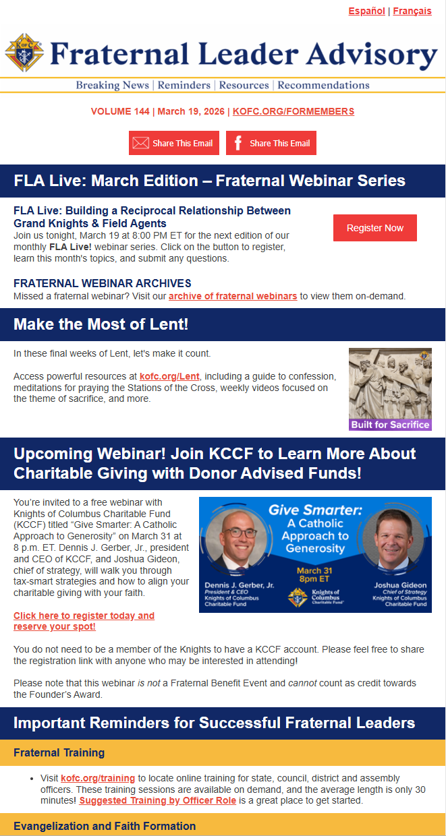
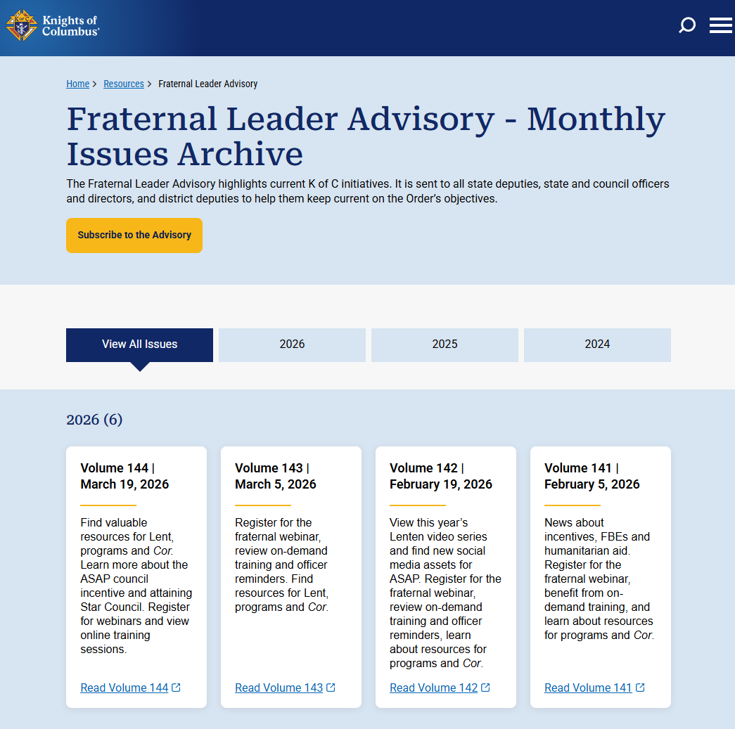
Supreme Provides Additional Training
Subscribe to the Fraternal Leader Advisory monthly update
Delivered to your in box
Click Here or https://www.kofc.org/en/news-room/fraternal-leader-advisory/index.html
Notes:
Don’w forget that Supreme provides additional training to help you grow as a leader in your council. One of the best ways to stay up to date is by subscribing to the Fraternal Leader Advisory, a monthly update delivered right to your inbox.
This resource provides important updates, best practices, and leadership insights straight from Supreme, helping you stay ahead and keep your council on track.
Take advantage of these resources, continue learning, and always look for ways to strengthen your council and serve your community.
Stay engaged, stay informed, and keep moving forward.

Slide 66
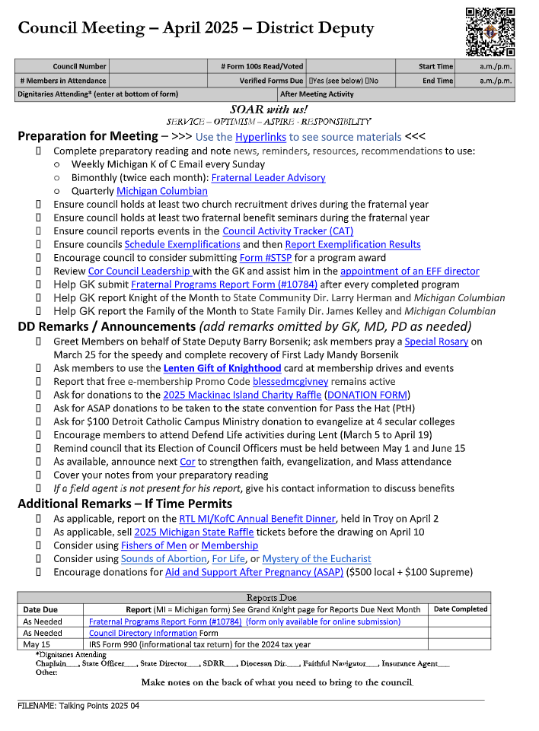
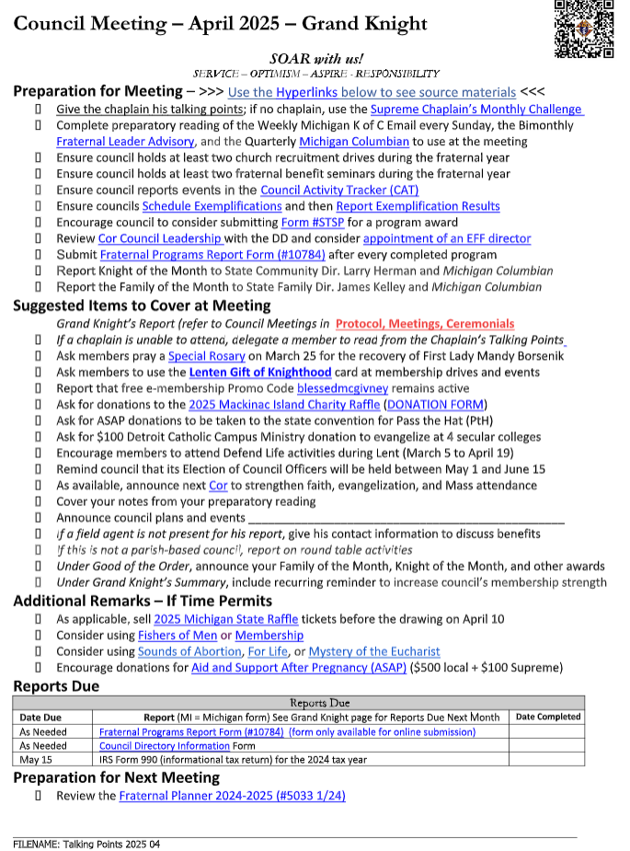
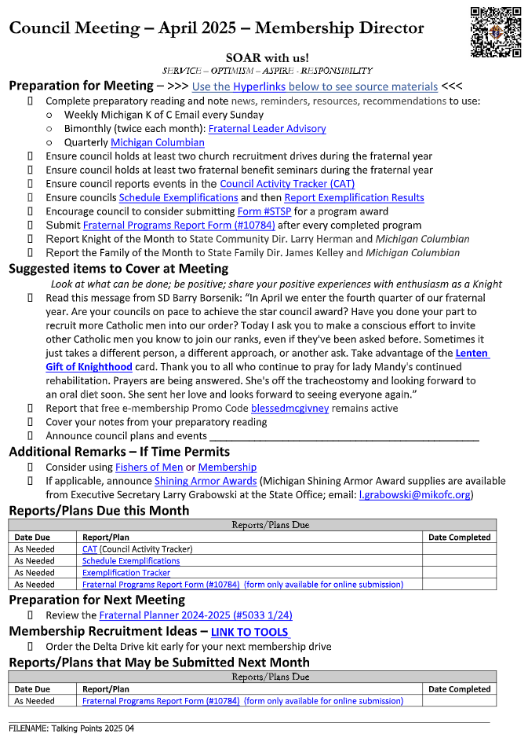
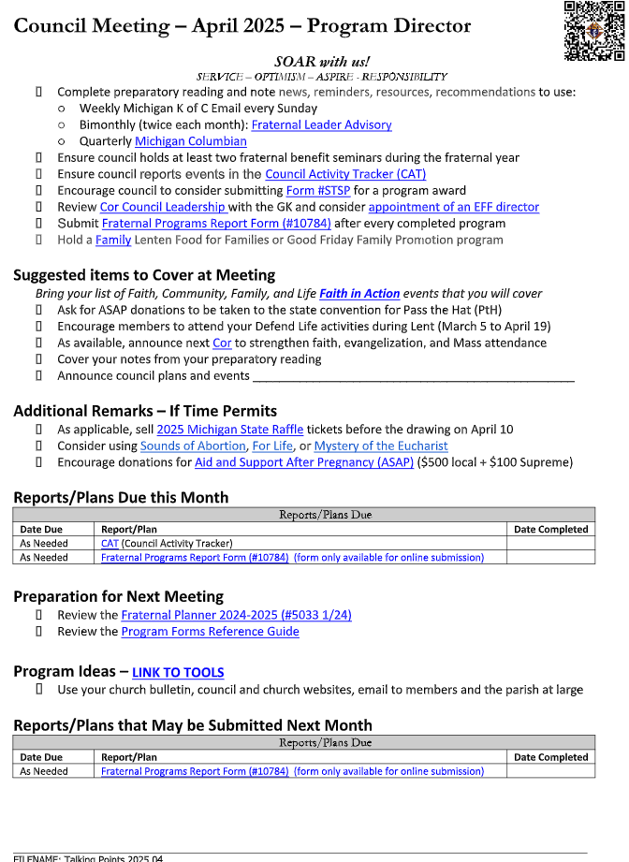
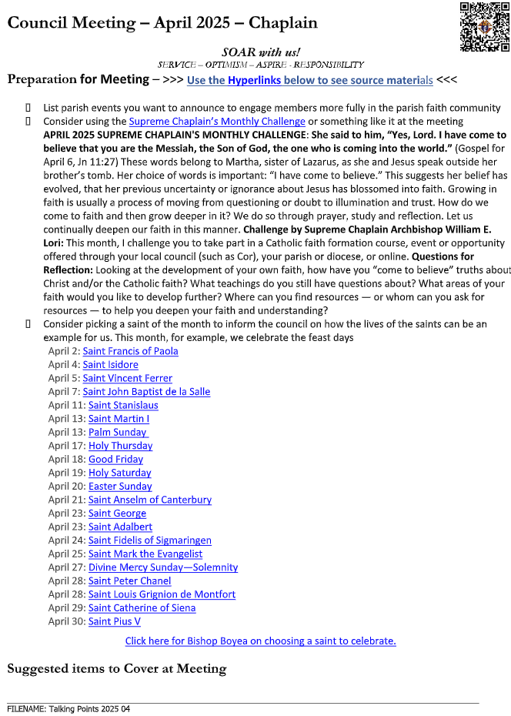
# 1 Resource Dan Remeika Talking Points
Ask your Grand Knight to forward this to you monthly
Notes:
For an easy way to stay organized and ensure your council is covering the right topics each month, look for Dan Remeika’s Talking Points email.
This valuable resource is sent to the Grand Knight, Program Director, Membership Director, and Chaplain. It provides:
✅ Key discussion points
✅ Important reminders
✅ Links to upcoming events
By following these updates, you can keep your council engaged, informed, and on the right path for success. Be sure to check your inbox and make this a regular part of your council planning!

Slide 67
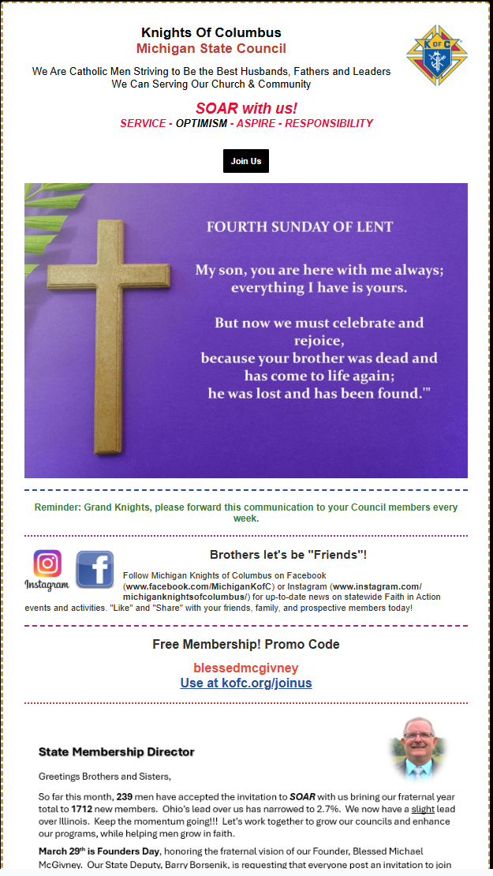
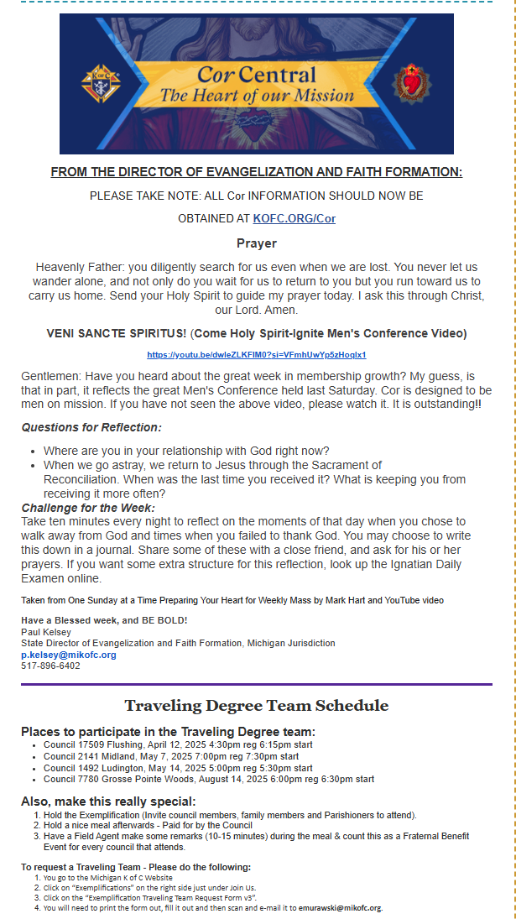
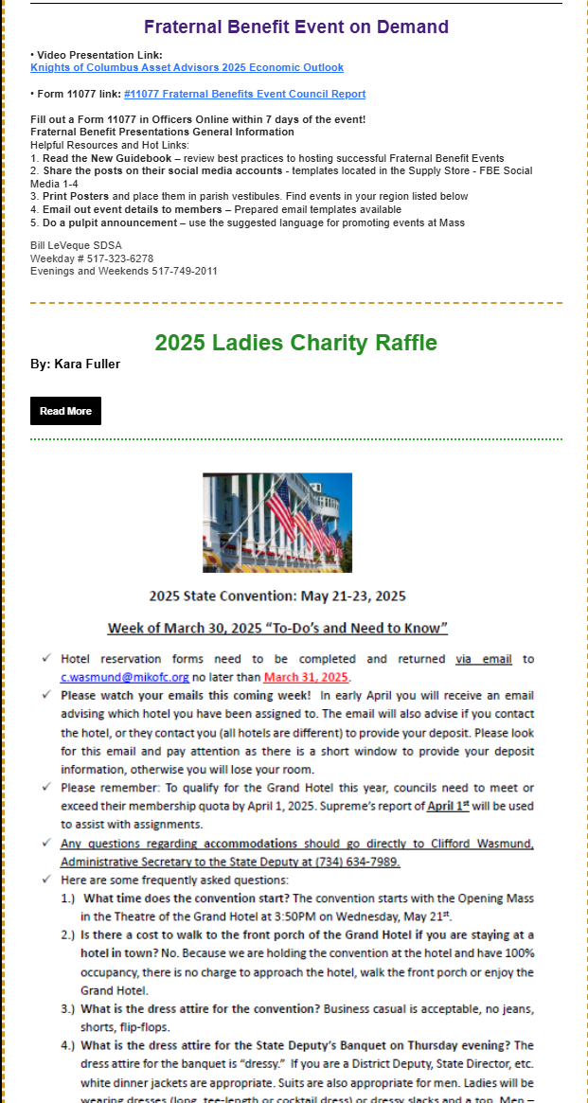
Sunday Afternoon Constant Contact
Notes:
Final Reminder: Stay Connected and Informed
Each Sunday, Paul Palka will send out a Constant Contact email with recent events, updates, and important Knights of Columbus happenings.
With so many valuable resources—Dan Remeika’s Talking Points, Supreme updates, and weekly emails—checking your Knights email regularly is essential.
By staying informed, you’ll keep your council engaged, organized, and ready for success.
I wish you all a great fraternal year and truly appreciate your commitment and attendance in this training. Vivat Jesus!

Slide 68
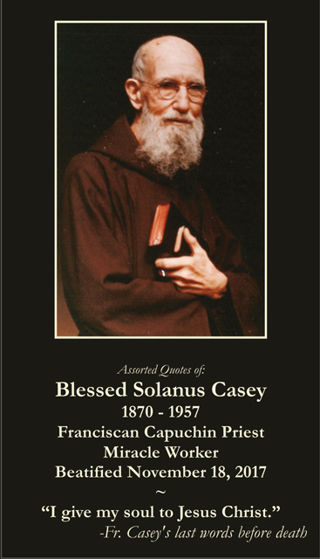
Let Us End In Closing Prayer – Blessed Solanus Casey
We ask for the intercession of Blessed Solanus Casey, a humble servant of the poor and a model of faith, hope, and charity. Lord, help us to follow his example of trust in Your divine providence, patience in times of trial, and unwavering commitment to serving others with love. May we, like him, seek to bring Christ to the world through our actions, words, and the work we do as Knights of Columbus. Bless our councils, our parishes, and our families. Strengthen us in faith, guide us in wisdom, and fill our hearts with the same humility and joy that Blessed Solanus displayed in his service. We pray that one day, Blessed Solanus Casey may be fully recognized as a saint, and that his life continues to inspire us to do “only for the glory of God.” We ask this through Christ, our Lord. Amen.
Vivat Jesus!
Notes:
Let Us Begin in Prayer
As we always do, let us start in prayer. We will pray for the canonization of Blessed Father Michael McGivney, asking for his intercession and guidance in our work.
"God, our Father, protector of the poor and defender of the widow and orphan, you called your priest, Blessed Michael McGivney, to be an apostle of Christian family life and to lead the young to the generous service of their neighbor. Through the example of his life and virtue, may we follow your Son, Jesus Christ, more closely, fulfilling his commandment of charity and building up his Body, which is the Church.
Let the inspiration of your servant prompt us to greater confidence in your love so that we may continue his work of caring for the needy and the outcast. We humbly ask that you glorify Blessed Michael McGivney on earth according to the design of your holy will. Through his intercession, grant the favor I now present to make this meeting meaningful to the men present. Through Christ our Lord. Amen."
Blessed Michael McGivney, pray for us!

